Slide 1
Chapter 7 Recommending Movies to Watch
How does Netflix recommend movies?

Slide 2
A Taste of
Machine learning
Data mining
Information retrieval

Slide 3
Product Recommendation
From opinion aggregation to recommendation
use existing knowledge about product ratings to advise customers on what to consume next
How does Netflix determine which movies (it thinks) you, personally, will be most interested in watching?
Netflix subscribers are at receiving end of its movie recommendations
Making recommendations requires Netflix to make predictions of movie ratings they don’t have (from you) by leveraging the data they do have about user’s (including your) preferences
Netflix does this by assuming and leveraging the wisdom of crowds
the more ratings they have to start with, the better they can expect their predictions will be

Slide 4
The Story of Net
Back in 1997, Reed Hastings grew frustrated by large sum of late fees he had racked up from a video store
rather than charging people per rental, why not charge them a flat rate per month?
a cap on the total number of movies that could be out at one time → to incentivize people to return DVDs
Netflix was founded in 1997 which initially operated as a traditional brick-and-mortar DVD rental store with a pay-per-rental pricing model
Opened online store in 1998: allowing people to shop for DVDs online and wait for them to arrive by mail

Slide 5
The Story of Net
In 1999, Netflix introduced flat monthly subscription model plus a cap on number of DVDs that could be rented out at one time (to incentivize their returns)
Over the years, Netflix is able to operate with great scalability and stickiness
Scalability: Netflix’s cost of on-boarding a new customer is much lower when they already have a lot of customers (e.g., cost of going from 100 customers to 101 was much higher for Netflix than cost of going from 1,000,000 to 1,000,001)
Stickiness: those using Netflix tend to stay rather than switching to another video provider

Slide 6
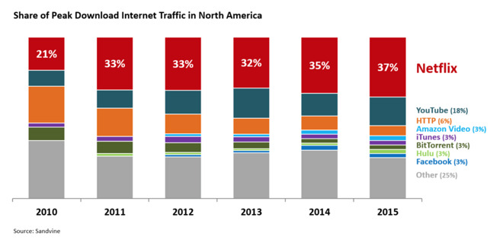
The Story of Net
By 2008, about 9 million Netflix users in US and Canada (10x increase over number of subscribers around 2000)
In 2008, Netflix migrated towards streaming movies and TV programs through Internet to Internet-connected devices
Blockbuster files for bankruptcy in 2010
From 2008 to 2015, Netflix’s customer increase 7 folds
% of peak Internet traffic in North America

Slide 7
About Software and AI
Amazon, Netflix, Facebook and many others are all software companies !!!
Why Software Is Eating the World by Marc Andreessen, 2011
Software Is Eating the World, but AI Is Going to Eat Software by Jensen Huang, 2017

Slide 8
Recommendation
What kind of game is it?
A “mind reading” game

Slide 9
Recommendation: A “Mind Reading” Game
Netflix offers several features to help you browse through movies, before choosing
filter them by genre (category)
sort them by rating
look at Critic’s Picks
consult Netflix Top 100
Most are “one-size-fits-all” features: appearing the same for you as they do for anyone else
Netflix recommend movies to you that it thinks you, personally, would like
it’s as if they are reading your mind, predicting which movies will fit your tastes before you have watched or rated them

Slide 10
Recommendation
As you watch/browse movies on Netflix, it builds up a history of your actions and behaviors in database
This information is passed through algorithms to make predictions about how you would rate other movies
As you submit ratings, add movies to your queues, or tell Netflix which movies you are not interested in, these actions are all impacting which movies will be recommended to you in the future
Effective recommendation system is critical to Netflix because it enhances user experience, increases customer loyalty, and helps with inventory control
Amazon recommends products based on your purchase and viewing history
YouTube recommends videos to you at end of each watching
Netflix uses history of all user behavior to build profile of each user’s taste in movies and how each movie is rated by users

Slide 11
Netflix Recommendation - Input
Find “patterns” hidden in data provided by crowd of movie raters
Each time a user rates a movie, her rating is stored in Netflix database
user’s ID
movie’s ID
number of stars (1-5)
date of rating
Over 60 million users; around 75,000 different movie titles
more than four trillion (4x10¹²) possible [user, movie] pairs
Dataset is sparse – several billion “valid” pairs

Slide 12
What Are Input Data Used For?
Input data is used during training phase of recommendation system to set parameters of its prediction algorithm to values that are expected to yield good-quality outputs (predictions)

Slide 13
Netflix Recommendation - Output
Predictions for ratings that a user would give to movies she hasn’t watched yet
Predicted ratings are not what is actually shown to viewers in the end
final output: series of short, rank-ordered lists of movies recommended to individual users
How to determine lists from predicted ratings?
top five predictions for movies a user hasn’t seen yet
all movies with a prediction of over 4 stars
etc.

Slide 14
Evaluating the Predictions
How to evaluate quality (performance) of prediction?
The true test of prediction is how many users actually like the recommended movies
this information is hard (or impossible) to collect
need some metric as proxy
Since we cannot evaluate predictions on ratings that we don’t know, evaluate ratings that we do know
evaluate error on how well our predictions on these known ratings match the actual values
the closer they match, the lower the error, and the higher quality we can expect in making predictions on the unknown ratings

Slide 15
Evaluating the Predictions
Use some data to tune (train) parameters of prediction system
Use prediction system to make predictions about target values (some known and some unknown)
Compare predicted values of known targets to their actual values to get an expectation of quality
(known) data → separated for training and evaluation
During training phase, need to “withhold” or “hold out” the evaluation ratings from the training ratings that we input to system

Slide 16
Evaluating the Predictions
Once we have both predicted and actual ratings to compare, how do we determine prediction quality?
Use Root Mean Squared Error (RMSE): measured for those [user (u), movie (i)] pair for which we have both prediction ( ) and actual rating ( ); say there are C such pairs
We evaluate how well our predictions on these known ratings match the actual rating values
the closer they match (the smaller RMSE), the higher quality we can expect in making predictions on unknown ratings
RMSE minimization problem

Slide 17
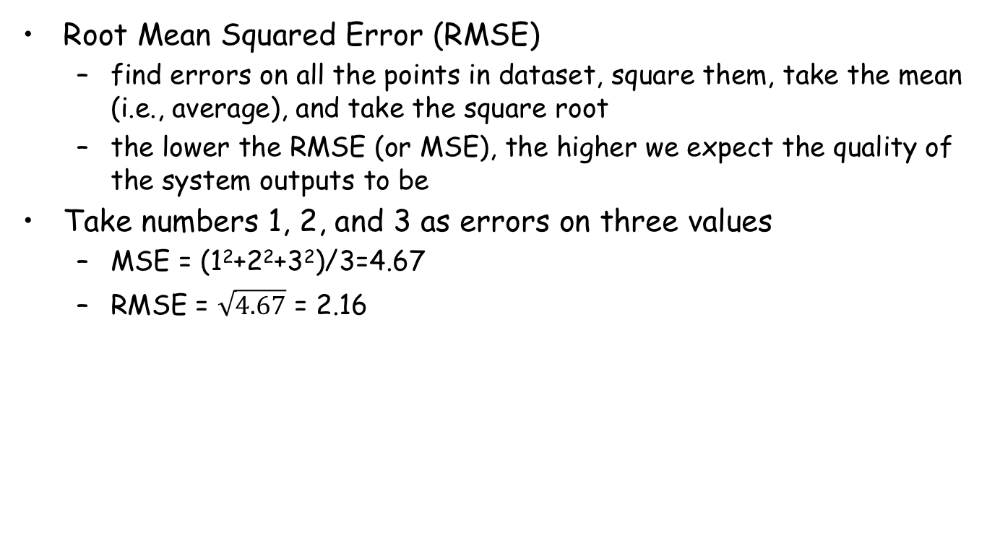
Root Mean Squared Error
Root Mean Squared Error (RMSE)
find errors on all the points in dataset, square them, take the mean (i.e., average), and take the square root
the lower the RMSE (or MSE), the higher we expect the quality of the system outputs to be
Take numbers 1, 2, and 3 as errors on three values
MSE = (1²+2²+3²)/3=4.67
RMSE = $\sqrt{4.67}$ = 2.16

Slide 18
A “Learning” Framework
Actual rating values in black form training data set to train predictor
Values in blue are also actual rating values used for evaluation
Predictor generates predictions for (C, I), (D, II), (E, III), (B, IV), and (F, 5)
Minimize RMSE to “tune” predictor
Apply predictor to predict ? and make recommendation
3.1
3.5
2.1
4.8
4.3
?

Slide 19
MSE of Naïve Predictor
Training set = {black #}
Test set = {blue #}
Average of training set
= 1.05

Slide 20
The Netflix Prize
Netflix’s original prediction algorithm was called CineMatch
In October 2006, Netflix Prize was announced to award $1 million to the team that could develop an algorithm which would improve RMSE by 10% over CineMatch
Netflix released over 100 million ratings (480,000 users and 17,770 movies) to public, as part of records from 1999 to 2005
could fit in memory of standard desktops in 2006 → making it easy for anyone in the world to participate in competition
on average, each movie was rated by more than 5000 users, and each user had rated more than 200 movies
actually a few users were responsible for pulling this average to 200, by rating a large number of movies (one user had rated over 17,000 movies!)
For majority of users, only a few ratings were available, posing an interesting challenge to aggregating users’ individual preferences

Slide 21
Netflix Prize Data Sets
(public) Training set to tune algorithm (~100 million ratings)
(public) Probe set (~1.4 million ratings): as often as they want to test*
(private) Quiz set çsubmit your prediction algorithm to run on Quiz set at most once a day
RMSE scores continuously updated on the “leaderboard” of Netflix Prize’s website
(private) Test* set (1.4 million ratings): for final decision
Probe, Quiz, and Test sets have similar statistical properties
*Term “test” is overloaded!

Slide 22
The Netflix Prize
Netflix held back a few million ratings from the training data that only they had access to
The test set of 1.4 million ratings would serve as the final evaluation to determine the winner
CineMatch gave RMSE of 0.9525 on the test set, which made the goal to drive RMSE below 0.9 x 0.9525 = 0.8573 on this set
improving RMSE by even 0.01 can actually make a significant difference in recommendations
More than 5000 teams worldwide entered more than 44,000 submissions
CineMatch was beaten within a week of start of competition in October 2006, but it would be almost three years until first team achieved more than a 10% improvement in June 2009
In the end, top two teams – The Ensemble and BellKor’s Pragmatic Chaos – achieved the same improvement of 10.06% on test set
Since the latter team had submitted their algorithm 20 minutes earlier, they were declared the winner

Slide 23
Netflix Prize Milestones

Slide 24
Building the Baseline Predictor
Obtaining few percent improvement in RMSE on Netflix’s dataset requires many algorithms blended together and thousands of model parameters tuned just right
Two of the first steps
baseline predictor
neighborhood model
Key idea: to leverage information from within the “crowd” of data we already have to infer user preferences and movie characteristics for making predictions

Slide 25
Example Dataset
Entries that are neither blue nor ? will be used as training data to base predictor on
Five blue entries are test data for evaluation
Five ? are final outputs for the system to predict in the end
In this example, 83% of table entries were filled vs. Netflix has only fractions of 1% of all possible ratings

Slide 26
Naïve Predictor
What will be a naïve predictor?
Average all entries in training set and attribute this average to all unknown entries
raw rating
predicted rating
MSE (of test set) =
= 1.05

Slide 27
Baseline Predictor
Relying on average overall rating in Netflix’s dataset is rather naïve - it is like using the same average customer review for every product on Amazon
What did we learn from last chapter on Amazon?
some reviewers tend to be easier/harsher critics
some movies are naturally better/worse than others
D gave (his highest) 3 to III, which received 4 and 5 from others; gave two 2s; the only person gave 1
harsh critic
What do we learn?
How about movie II (from D)?
the value we predict for D’s rating of movie II should reflect this
How about movie III from others?
received 4 and 5 (except from D) → expect more likely to be well received by those who haven’t rated it yet

Slide 28
Baseline Predictor
Each user and each movie has its own rating bias
Baseline predictor aruges that rating for a specific user-movie pair will be offset from overall average by corresponding biases as
Biases are determined by user-movie interactions
how a given user rated movies
how a given movie was rated by users
Intuitive approach
for a user, say D, find his average rating across all movies he critiqued (in training data), and compare this to overall average
if higher, lenient relative to whole dataset
if lower, critical relative to whole dataset
for a movie, find its average over all users that critiqued it, and compare that to average

Slide 29
Baseline Predictor
For “harsh” User D, 4 ratings in training data: 2, 3, 1, and 2
For “good” movie III, 4 ratings: 4, 5, 3, and 5

Slide 30
Baseline Predictor
User A, Movie II?
None of predictions go below 1 or go above 5
User E, Movie III, 3.5 + 0.83 + 0.75 = 5.08 ?
actual ratings are bounded by 1 and 5

Slide 31
Baseline Predictor
MSE of test set =
Improvement from naïve predictor = (1.05 – 0.543)/1.05 = 48%

Slide 32
Help from “Neighbors”
User-movie interaction: average along single row or single column
How can you do better?
Crowds are my neighbors!
Similarities between movies and between users
Neighborhood model
two users are “neighbors” if they share particularly similar (or dissimilar) opinions about movies
two movies “neighbors” if they are rated particularly similar (or dissimilar) by users
one kind of collaborative filtering method – filter dataset for patterns by looking at how “entities” collaborate (how they rate or are rated)

Slide 33
Similarity and Dissimilarity
Anna and Ben are positively correlated (similar preferences)
if we know Anna likes “Jurassic Park,” we would expect Ben to like it, too
if we know Anna does not like it, we would expect Ben not to like it either
Negatively correlated if Ben did not like first two movies, but liked second two
if Anna likes “Jurassic Park,” we would expect Ben not to like it, and vice versa
Similarity/dissimilarity between users

Slide 34
Similarity and Dissimilarity
 | Good Will Hunting | A Beautiful Mind
Anna
Ben
Charlie
Dana |  | ?
👍
👍
Movies are positively correlated
→ ? =
👍
👍
👍
👎
👎
👍
Other people’s opinions indicated that these two movies are positively correlated
Movies are negatively correlated
→ ? =
👎

Slide 35
How to Quantify Similarity?
Cosine similarity to compute movie-to-movie similarity
cos(Angle)

Slide 36
Cosine Similarity
Cosine similarity: 4 possibilities of angle between 2 line segments, I and II
Very small angle (a): 2 line segments point in similar directions → strong positive correlation
Very large angle (d): 2 line segments point in opposite directions → strong negative correlation
Angles of intermediate values (b)(c): segments are not correlated

Slide 37
Cosine Similarity
(AII,BII)
(AI,BI)
Two line segments represent two movies I and II (in 2-dimension)
AI: indication of rating that User A gave to Movie I
BI: indication of rating that User B gave to Movie I
AII of A to II
BII of B to II
The smaller the angle between two segments, the more similar the movies are, and the larger, the more dissimilar

Slide 38
Cosine Similarity
In (a), User A rated both I and II positively, as did User B → strong similarity (positive correlation) between two movies
In (d), User A rated Movie I positively and II negatively, and User B also rated them opposite to each other → strong dissimilarity (negative correlation) between two movies
(a) | Movie I | Movie II
User A | 👍 | 👍
User B | 👍 | 👍
(d) | Movie I | Movie II
User A | 👍 | 👎
User B | 👍 | 👎

Slide 39
Cosine Similarity
Cosine similarity: given segments A = (A₁, A₂, …, A_{n}) and B = (B₁, B₂, …, B_{n}) [in n-dimension]
Cosine of angle between vectors (AI, BI, …) for Movie I and (AII, BII, …) for Movie II
denominator normalizes sum in nominator by length of movie “segments,” thereby restricting this to lie between -1 and +1

Slide 40
Quantify Similarity
In numerator, each term is product of how each user rated both movies
if he rated them both “good” or both “bad,” the term will be positive
otherwise it will be negative
Do not compute similarity based on absolute ratings, but rather based on error between actual values and baseline predictor
error
-
=

Slide 41
Quantify Similarity
error
For movie I, entries in training data for A, B, D, E, and F
For movie II, entries in training data for Users B, C, and F
For movie III, entries in training set for Users A, B, D, and F
For movie V, entries in training set for Users A, B, C, D, and E
(BI, FI) & (BII, FII)
(AIII, BIII, DIII)
&
(AV, BV, DV)

Slide 42
Properties of Cosine Similarity
Always lie between 1 and +1
+1 for perfect positive correlation
a value close to +1 is a strongly positive correlation (i.e., there is a high degree of similarity)
-1 for perfect negative correlation
a value close to -1 is a strongly negative correlation (i.e., there’s a high degree of dissimilarity)
0 for complete lack of correlation
a value close to 0 means there is only a weak correlation (i.e., neither similar nor dissimilar)
Movies III and V ?
→ positively correlated
Movies I and II ?
→ not correlated one way or another

Slide 43
Choose Neighbors Wisely
Neighborhood model uses movie-to-movie (and user-to-user) similarity
Neighborhood model
two movies are “neighbors” if they are rated particularly similar (or dissimilar) by users
two users are “neighbors” if they share particularly similar (or dissimilar) opinions about movies
How to go from similarity to neighbor(s)?
top 3 highest |similarity values|
|similarity value| above some threshold
absolute value: either positive or negative

Slide 44
Choose Neighbors Wisely
For instance, choose best single neighbor in
movie in the column selects movie in the row as neighbor, e.g., V chooses II as neighbor
Will II choose V, since similarity matric is symmetric?
No
II’s correlation with IV is larger than (in absolute terms) with V, so II chooses IV as its neighbor

Slide 45
Choose Neighbors Wisely
Representing neighbor selections as graph
Each movie is a node, pointing to its chosen neighbor
V chooses II as its positively correlated neighbor
II chooses IV as its negatively correlated neighbor
“N” means correlation is negative, and “P” means it’s positive

Slide 46
Choose Neighbors Wisely
What to do with neighbors?
Use them to improve quality of baseline predictor
naïve
+
=
baseline
biases
error for each user-movie pair
actual (raw) ratings
-
=

Slide 47
Neighborhood Method
similarity
Look at movie V and user C
Movie V’s closest neighbor is II, because they have a high positive correlation (+0.88)
User C rated Movie II, and baseline predictor made error of +0.67 in that rating
What does this error tell us?
Baseline predicts too low by 0.67 for C-II pair
Since V is similar to II, chances are baseline predictor was too low as well in predicting User C’s rating of Movie V (2.60)
So, add 0.67 to baseline prediction of 2.60
error = actual - baseline
baseline
actual
too low
+ 0.67 = 3.27
+0.27
too high
vs.

Slide 48
Neighborhood Method
Movie IV’s closest neighbor is II, which has a (perfect) negative correlation (-1.00)
Error of User B rating Movie II using baseline predictor was +0.17
What does this error tell us?
Baseline predicts too low by 0.17 for B-II pair
Since IV is dissimilar to II, baseline prediction of B’s rating on IV may have been too high
So, subtract 0.17 from baseline prediction of 3.50
actual - baseline
baseline
actual
- 0.17 = 3.33
+0.33
too high
vs.
vs.
0.5 too high

Slide 49
Neighborhood Predictor
Neighborhood predictor using the closest neighbor
if correlation is positive, add neighbor’s baseline error
if correlation is negative, subtract neighbor’s baseline error
can be extended to using more neighbors
As negative feedback by using error made by baseline as a type of feedback signal
vs.
56% over naïve predictor
14% over baseline predictor

Slide 50
Performance of Predictors
two closest neighbors
least squares minimization

Slide 51
Baseline Predictor
Each user and each movie has its own rating bias
For a user, say D, find average rating across all movies he critiqued (in training data), and compare this to overall average
if higher, lenient relative to whole dataset
if lower, critical relative to whole dataset
For a movie, find its average rating across all users that critiqued it, and compare this to overall average

Slide 52
Baseline Predictor
For User D, 4 ratings in training data: 2, 3, 1, and 2
For movie III, 4 ratings: 4, 5, 3, and 5
baseline prediction
= # of movies rated by u
= # of users rated movie i
These average might not minimize RMSE!
Least squares
choose parameters {b_{u}, b_{i}} to minimize MSE:
the minimization is over all N + M parameters, where N is number of users and M number of movies in training set

